Slide 1

By Owais Ahmed Khan

Slide 2
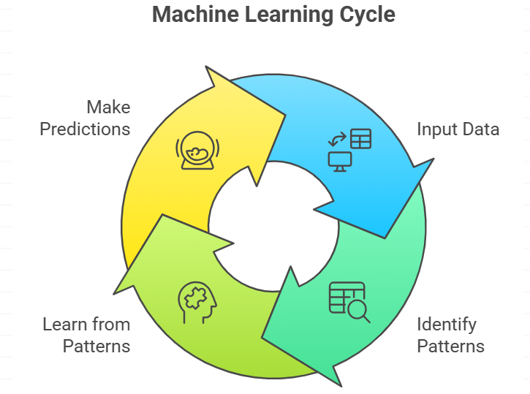

Slide 3
Problems with Imbalanced data set
In ML everything is about data.
We give data to our ML model.
"A model identifies patterns within the data, learns from them, and then makes predictions based on that learning.“
Imbalanced datasets can lead towards biased models, where the model is biased towards the majority class.
Data
ML Model
Recognize Pattern
Learn
Predict

Slide 4
Poor Accuracy
Models trained on imbalanced datasets may have low accuracy on minority classes, as the model is not exposed to enough data from that class during training.
Accuracy performance metrics can be decisive when dealing with imbalanced data.
The confusion matrix, precision, recall, and F1 score give better intuition of prediction results as compared to accuracy.

Slide 5



DATA
Prediction

Slide 6
True Positives (TP):
Instances where the model correctly predicts a positive class when it is indeed positive. Consider a cancer diagnostic model: a true positive would occur when the model correctly identifies a patient with cancer as having the disease. TP is a vital measure of the model's ability to recognize positive instances accurately.

Slide 7
True Negatives (TN):
Instances where the model correctly predicts a negative class when it is indeed negative. Continuing the medical analogy, a true negative would be when the model correctly identifies a healthy patient as not having the disease. TN reflects the model's proficiency in recognizing negative instances.

Slide 8
False Positives (FP):
Instances where the model incorrectly predicts a positive class when it should have been negative. In the medical scenario, a false positive would mean the model wrongly indicates a patient has the disease when they are, in fact, healthy. FP illustrates instances where the model exhibits overconfidence in predicting positive outcomes.

Slide 9
False Negatives (FN):
Instances where the model incorrectly predicts a negative class when it should have been positive. In the medical context, a false negative would be when the model fails to detect a disease in a patient who actually has it. FN highlights situations where the model fails to capture actual positive instances.

Slide 10

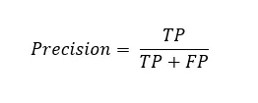
Precision and Recall
Imagine you are a detective to solve a crime.
Precision: Every suspect you arrest is guilty.
Example:
If you arrest 10 people and only 8 are guilty
Precision = 80% (8/10)

Slide 11

Recall
What is the possibility of people who are guilty not being arrested?
Example :
In an earlier example out of 10, 8 people are guilty.
Assume crime was committed by 20 people out of which only 8 people were arrested.
Recall : 8 / 20 = 40%

Slide 12
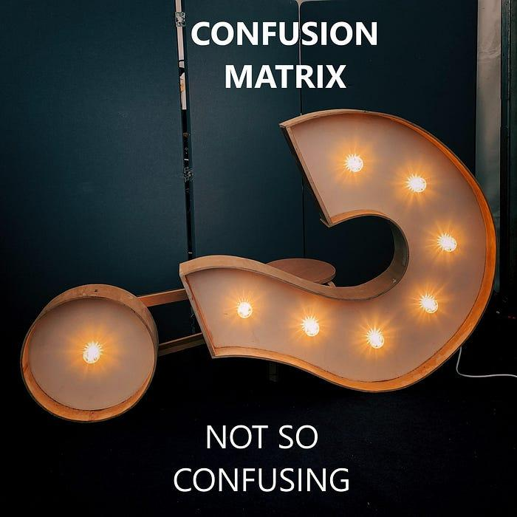

Slide 13
Confusion Matrix
It is a performance measurement for machine learning classification problem where output can be two or more classes.
It is a table with 4 different combinations of predicted and actual values.
 | PREDICTED CLASS
ACTUAL CLASS |  | Class=Yes | Class=No
 | Class=Yes | (TP) | (FN)
 | Class=No | (FP) | (TN)

Slide 14
True Positives (TP): Guilty people correctly identified as guilty.
True Negatives (TN): Innocent people correctly identified as innocent.
False Positives (FP): Innocent people incorrectly identified as guilty.
False Negatives (FN): Guilty people incorrectly identified as innocent.
 | PREDICTED CLASS
ACTUAL CLASS |  | Class=Yes | Class=No
 | Class=Yes | (TP) 50 | (FN) 7
 | Class=No | (FP) 3 | (TN) 40

Slide 15
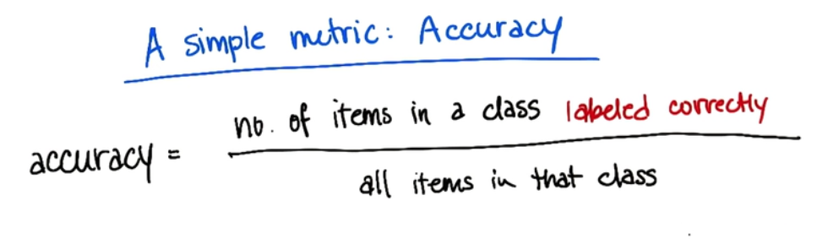

Slide 16
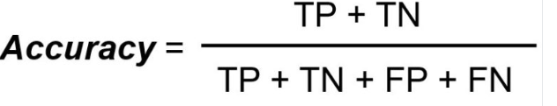
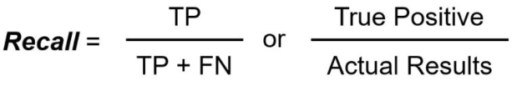

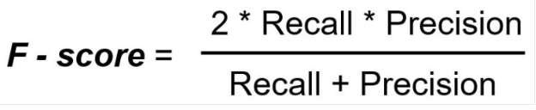

Slide 17
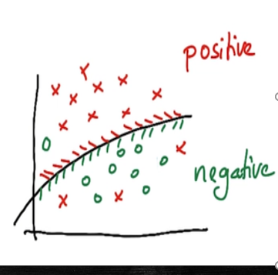
Confusion Matrix?
 | PREDICTED CLASS
ACTUAL CLASS |  | Class=Yes | Class=No
 | Class=Yes | (TP) | (FN)
 | Class=No | (FP) | (TN)

Slide 18
Confusion Matrix?
 | PREDICTED CLASS
ACTUAL CLASS |  | Class=Yes | Class=No
 | Class=Yes | (9) | (3)
 | Class=No | (1) | (8)

Slide 19
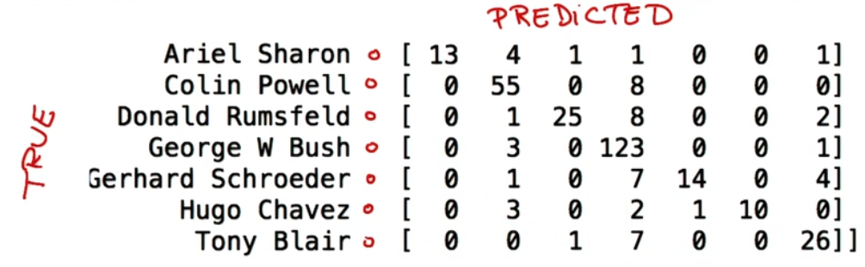

Slide 20
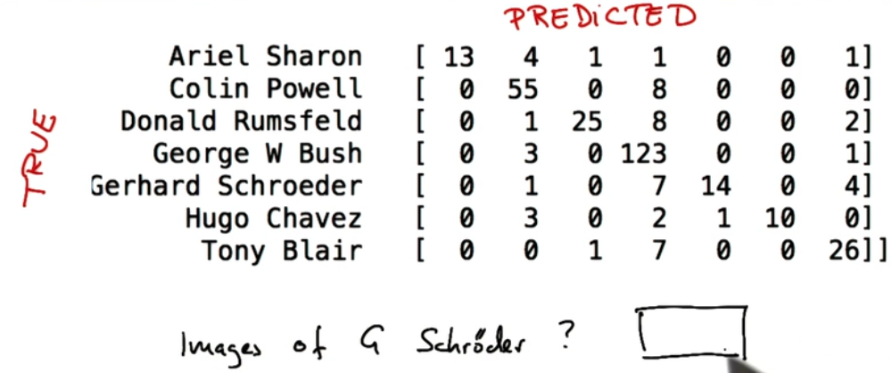

Slide 21
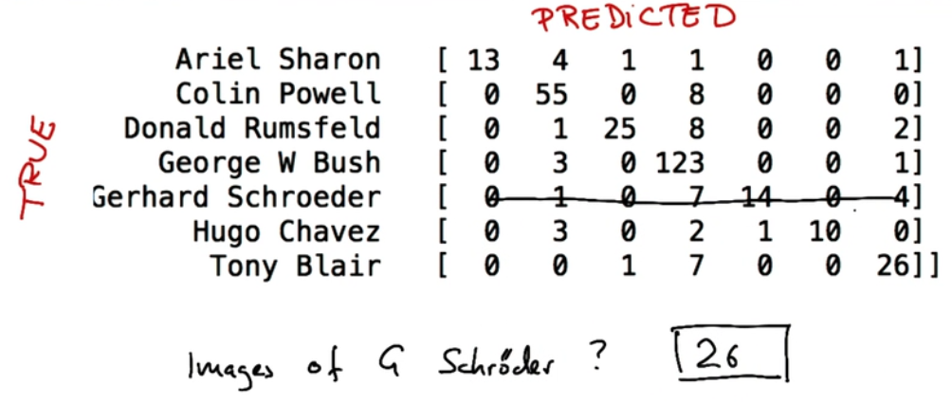

Slide 22
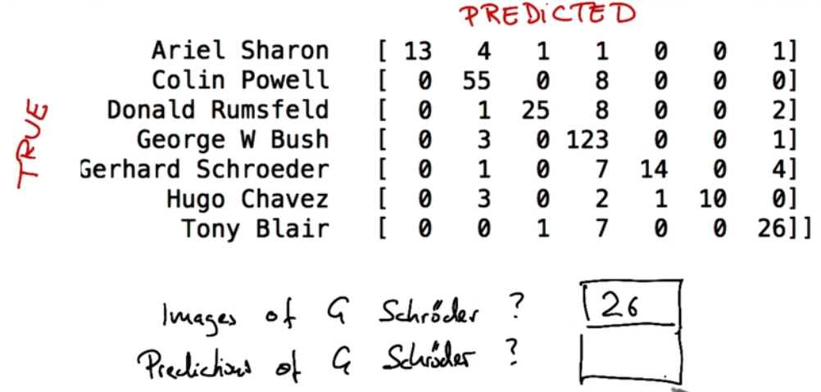

Slide 23
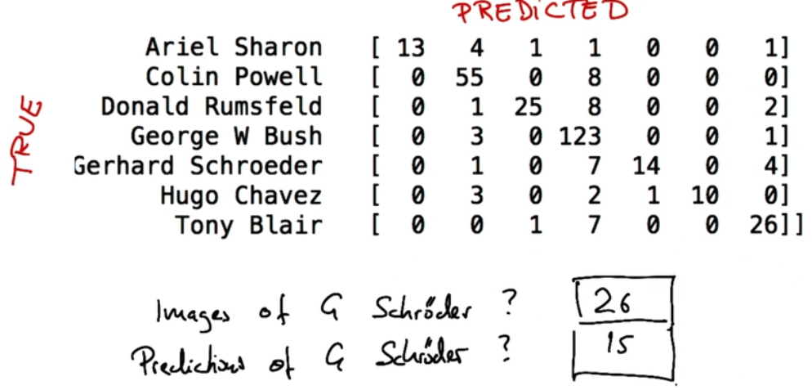

Slide 24
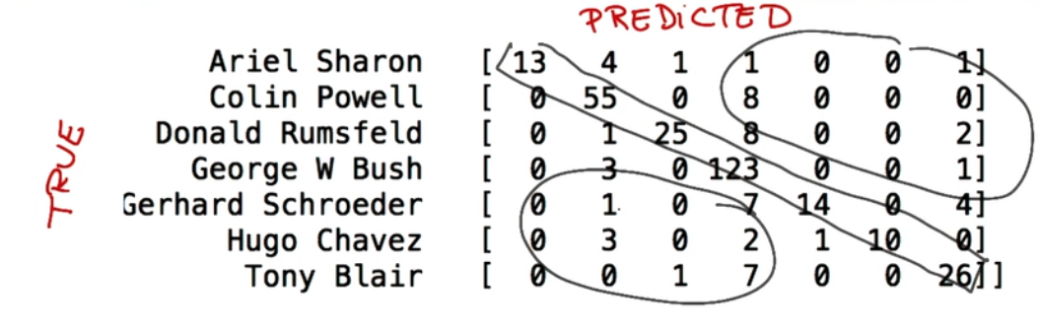
At the diagonal all correct predictions/classes
Other than diagonal entries are misclassifications

Slide 25
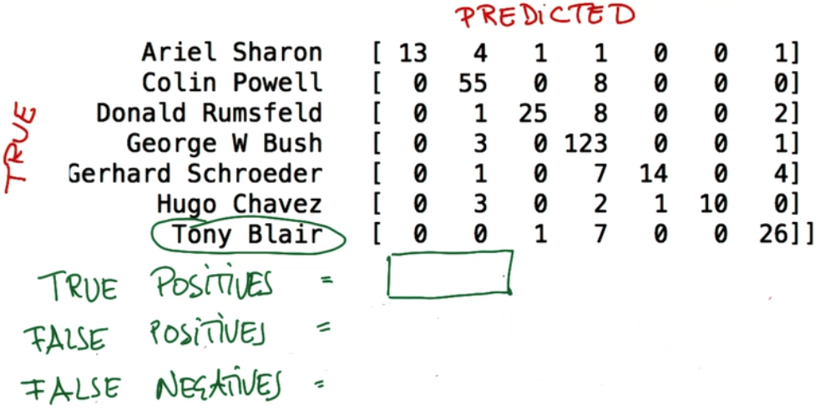

Slide 26
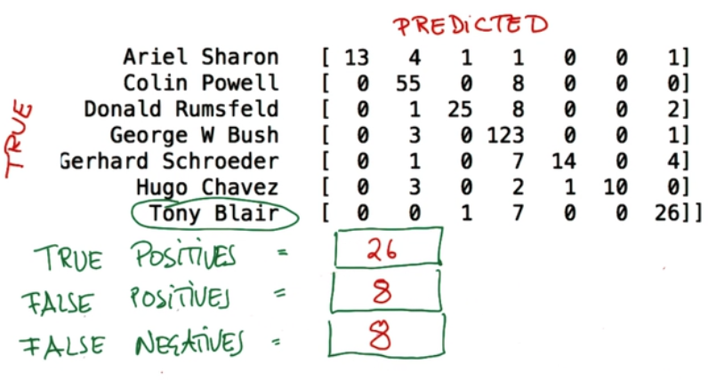

Slide 27
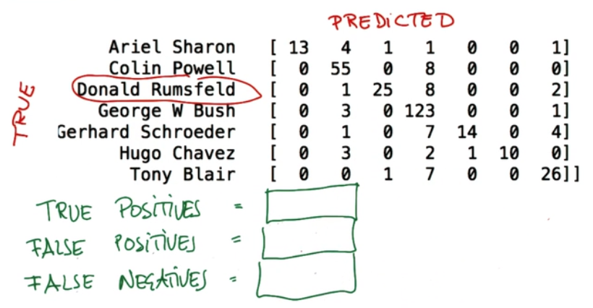

Slide 28
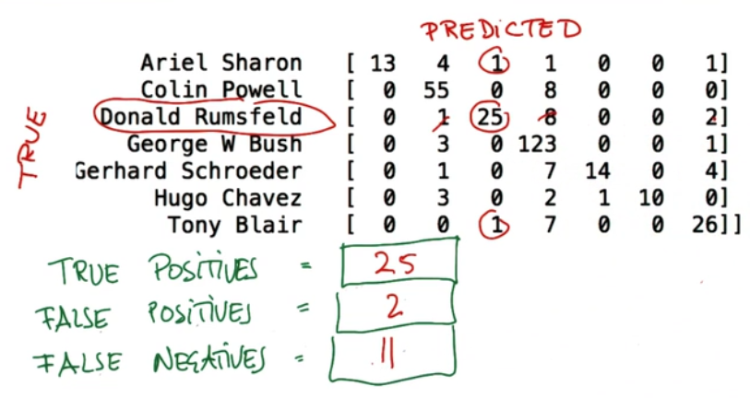

Slide 29


